Slide 1
Modflow 6 LAB: Customizing for Flow, Transport and Geothermal Modeling
Introduction to MODFLOW 6
Dr. Mike Müller
Lúcia Pedrosa

Slide 2
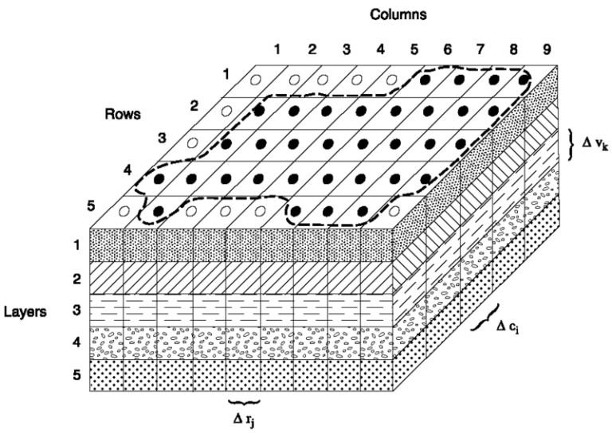
🌍 What is MODFLOW 6?
MODFLOW 6 (MF6) is the latest generation of the U.S. Geological Survey (USGS) MODFLOW groundwater modeling framework. It represents a complete redesign of the classic MODFLOW series (MODFLOW-2005, MODFLOW-NWT, MODFLOW-USG, etc.), combining the best features of previous versions into a unified, flexible, and modular system.

Slide 3
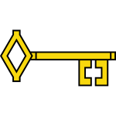
Key characteristics:
Unified Framework: common platform for simulating multiple hydrologic processes such as groundwater flow (GWF), groundwater transport (GWT), and exchanges between models.
Modular and Object-Oriented Architecture: Each process, model, and package is implemented as a modular unit, allowing flexible model composition. You can run multiple models (e.g., GWF + GWT) within the same simulation and define exchanges between them (e.g., flow coupling, solute transport).
Numerical Improvements: Enhanced iterative solver (IMS) package with better control over convergence and performance. Advanced time-stepping and adaptive convergence checks. Support for structured (DIS), vertex-based (DISV), and unstructured (DISU) grids.

Slide 4
Key characteristics:
3. Numerical Improvements: Enhanced iterative solver (IMS) package with better control over convergence and performance. Advanced time-stepping and adaptive convergence checks. Support for structured (DIS), vertex-based (DISV), and unstructured (DISU) grids.
4. Inter-model Coupling: Native support for GWF–GWF exchanges (linking aquifers or model domains). Support for GWF–GWT coupling (flow and transport interactions). Facilitates integrated groundwater–surface water or multi-layered aquifer modeling.

Slide 5
Key characteristics:
5. Enhanced Output Control and Post-processing:
Output control (OC) allows users to customize which variables are written and at what frequency. Head, budget, and concentration outputs can be easily parsed using FloPy or PyMF6.

Slide 6


Internal Structure & Hierarchy
MODFLOW 6 uses three primary components:
Simulation (SIM): The top-level container that manages time, models, and exchanges.
Model (GWF, GWT, etc.): Represents a specific process (flow, transport, etc.). Each model is composed of packages.
Package: Defines parameters, boundary conditions, and solver settings.

Slide 7
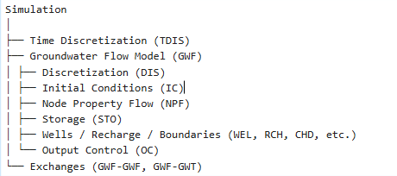
Internal Structure & Hierarchy
Packages are the building blocks where each represents a physical process or numerical control (e.g., discretization, boundary conditions, solver settings).
Example:

Slide 8
Package struture
Common package categories:
Discretization: DIS, DISV, DISU
Properties: NPF (flow properties), STO (storage)
Initial & Boundary Conditions: IC, CHD, WEL, RCH, DRN, RIV, GHB, EVT
Solver & Output: IMS, OC
Coupling & Exchanges: EXG, GWF-GWT connectors

